Slide 1

G2M Cab Company Case Study
Kymber Nichols Virtual Internship
20-Feb-2025

Slide 2

Agenda
Executive Summary
Problem Statement
Approach
EDA
EDA Summary
Recommendations

Slide 3
Executive Summary
Problem Statement: XYZ company is seeking to acquire a cab company.
Objective: Provide actionable insights about the cab industry using the provided dataset.
Analysis Approach
Exploration of Data
Comparative Data Summary
Development of Hypotheses
Results of Hypotheses
Key Takeaways
Recommendations

Slide 4






The Dataset
Dataset Records and Features
Cab_Data:
Records: 359,392
Features: 16
Transaction_ID:
Records: 20
Features: 3
Customer_ID:
Records: 49,171
Features: 4
City:
Records: 440,098
Features: 3
Additional Collected Dataset
US_holidays:
Records:
Features
Data Time Frame:
1-31-2016 to 12-31-2018
Total Records: 359,392
Total Features master1_df: 26
Total features master_US_df: 30
Transaction_ID
Cab_Data
Customer_ID
City
US_holidays
cab_df
transaction_df
customer_df
city_df
holidays_df
cab_transaction_df
customer_df
cab_transaction_customer_df
city_df
master1_df
master-US_df
The pandas data frame master1_df is used for all questions but holidays. The holiday questions used data frame master_US_df.

Slide 5
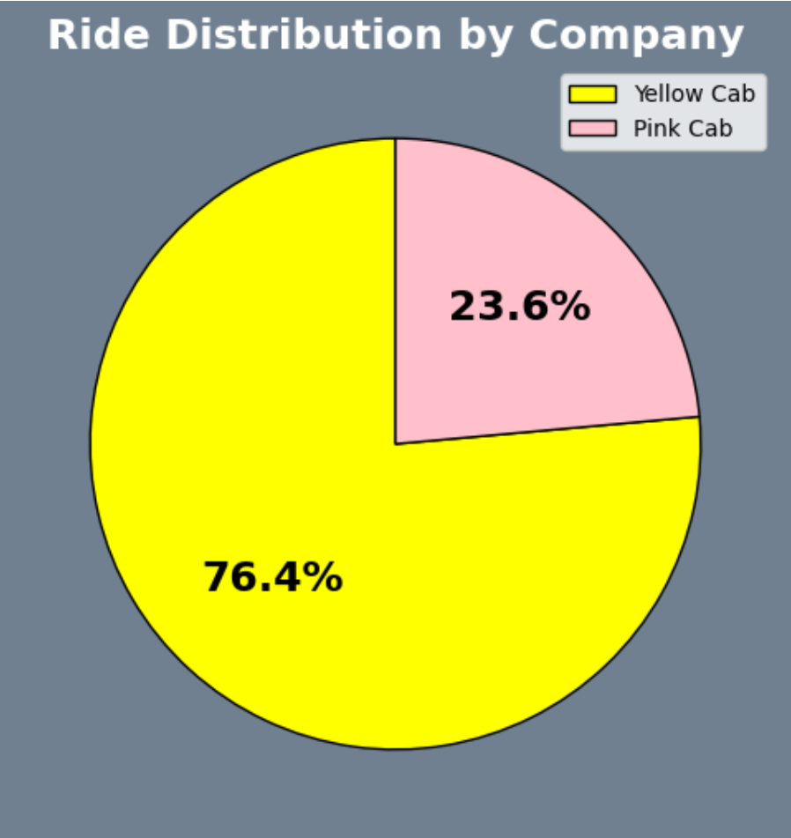
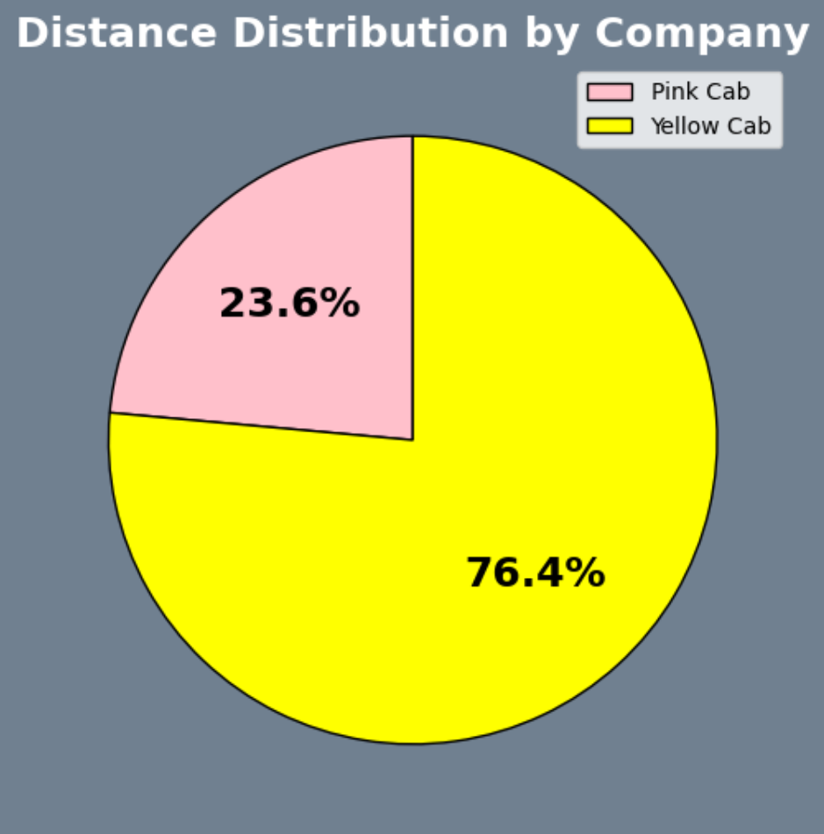
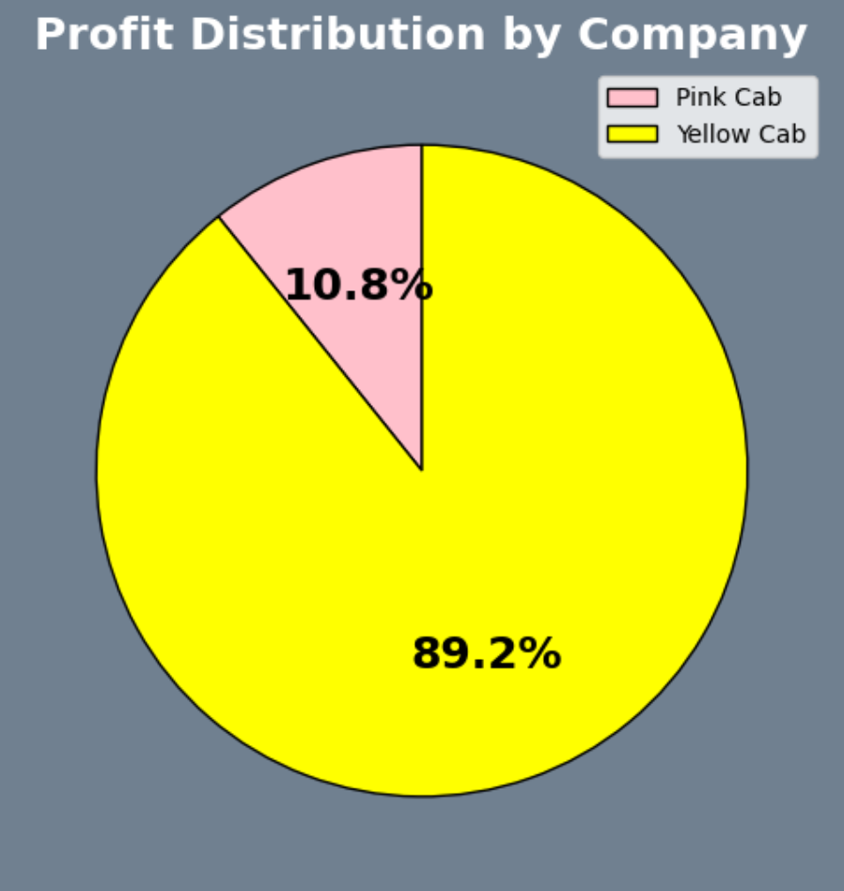
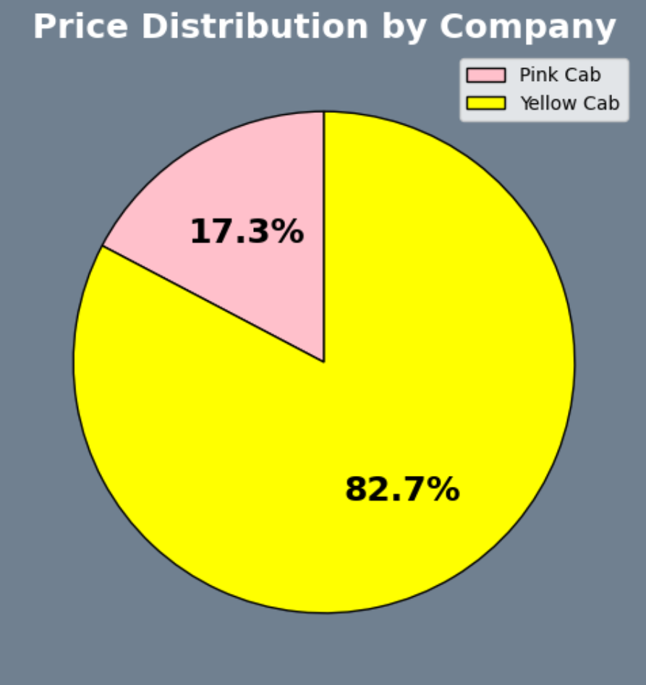
Cab Company Summary
Cab Companies Evaluated:
Yellow Cab
Pink Cab
Total Number of Rides: 359,392
Yellow Cab: 274,681
Pink Cab: 84,711
Total Kilometers Travelled: 8,110,490.58
Yellow Cab: 6,199,417.47
Pink Cab: 1,911,073.11
Total Profit Generated: $49,327,701.49
Yellow Cab: $ 44,020,373.17
Pink Cab: $ 5,307,328.32
Total Price Charged: $152,182,138.52
Yellow Cab: $ 125,853,887.19
Pink Cab: $ 26,328,251.33
Service Area: 19 Cities
Yellow Cab: 19
Pink Cab: 19

Slide 6
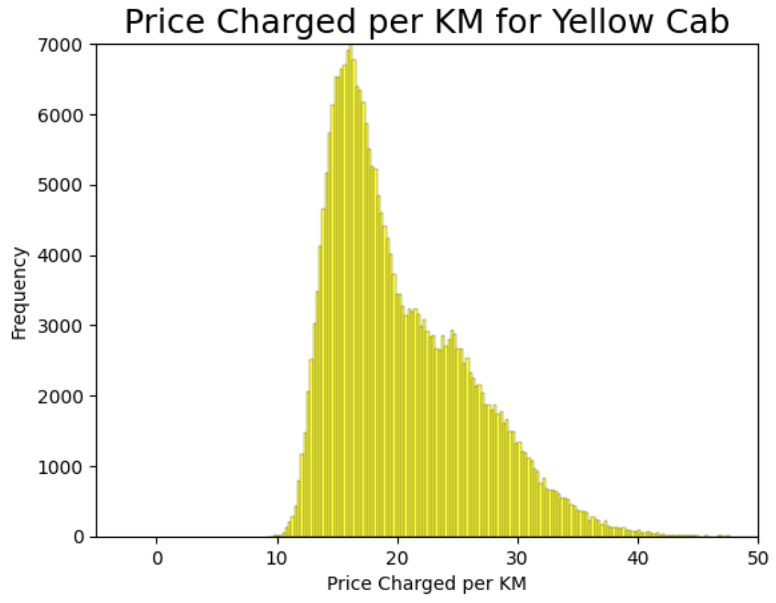
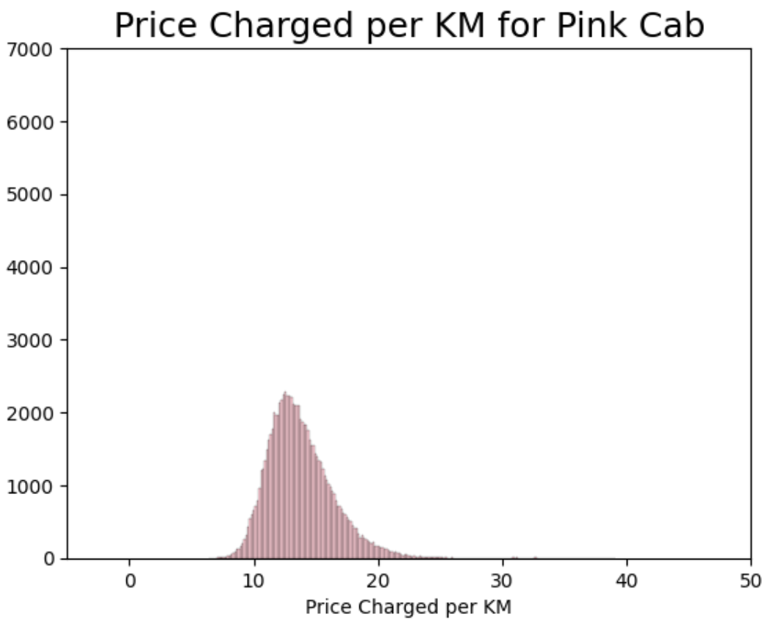
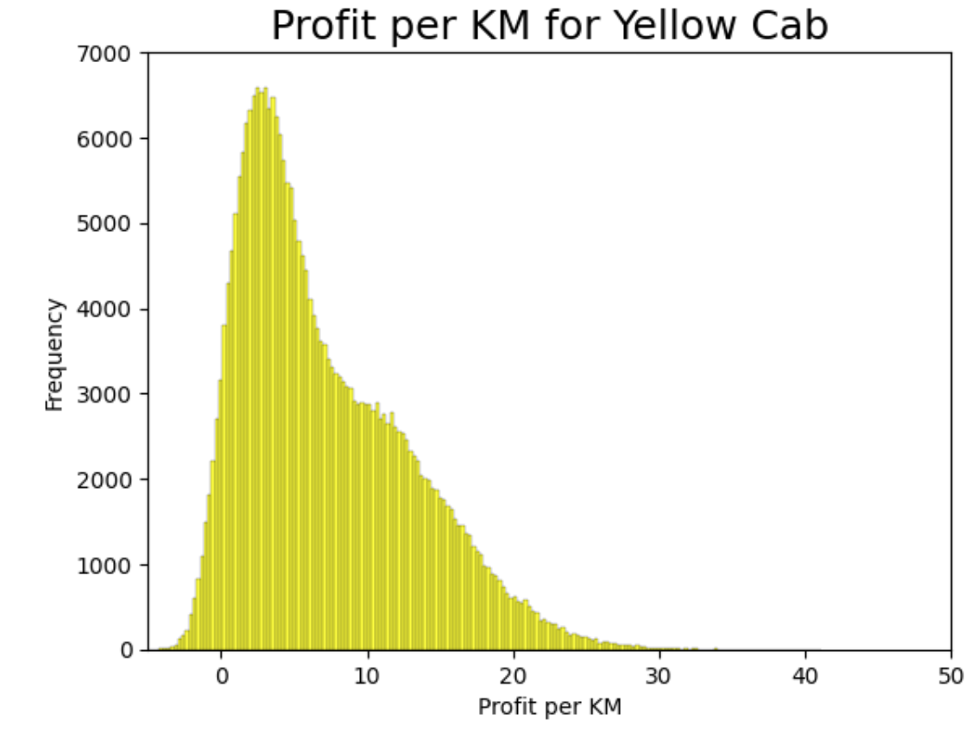
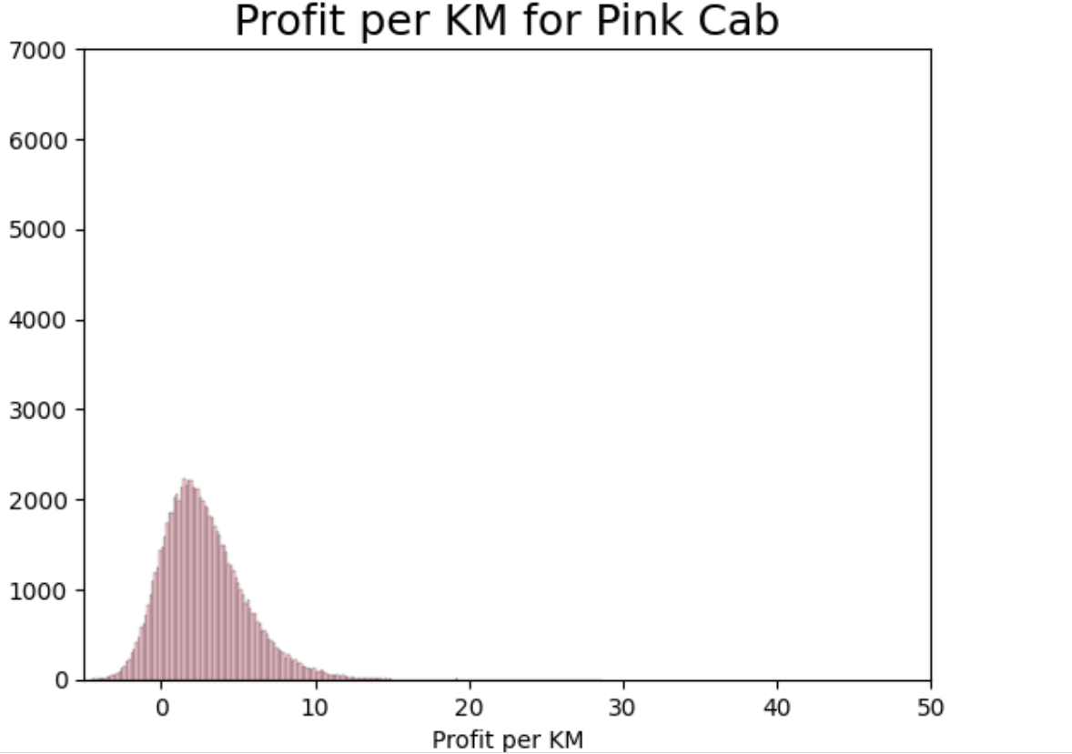
Price to Profit per KM Summary
Average Price Charged per KM: $ 18.77
Yellow Cab: $ 20.31
Pink Cab: $ 13.77
Median Price Charged per KM: $ 17.15
Yellow Cab: $ 18.75
Pink Cab: $ 13. 40
Minimum Price Charged per KM: $6.34
Yellow Cab: $ 9.16
Pink Cab: $ 6.34
Maximum Price Charged per KM: $ 53.96
Yellow Cab: $ 53.96
Pink Cab: $ 39.05
Average Profit per KM: $
Yellow Cab: $ 7.11
Pink Cab: $ 2.77
Median Profit per KM: $
Yellow Cab: $ 5.60
Pink Cab: $ 2.42
Minimum Profit per KM: $
Yellow Cab: $ -5.00
Pink Cab: $ -4.91
Maximum Profit per KM: $
Yellow Cab: $ 41.12
Pink Cab: $ 28.65

Slide 7
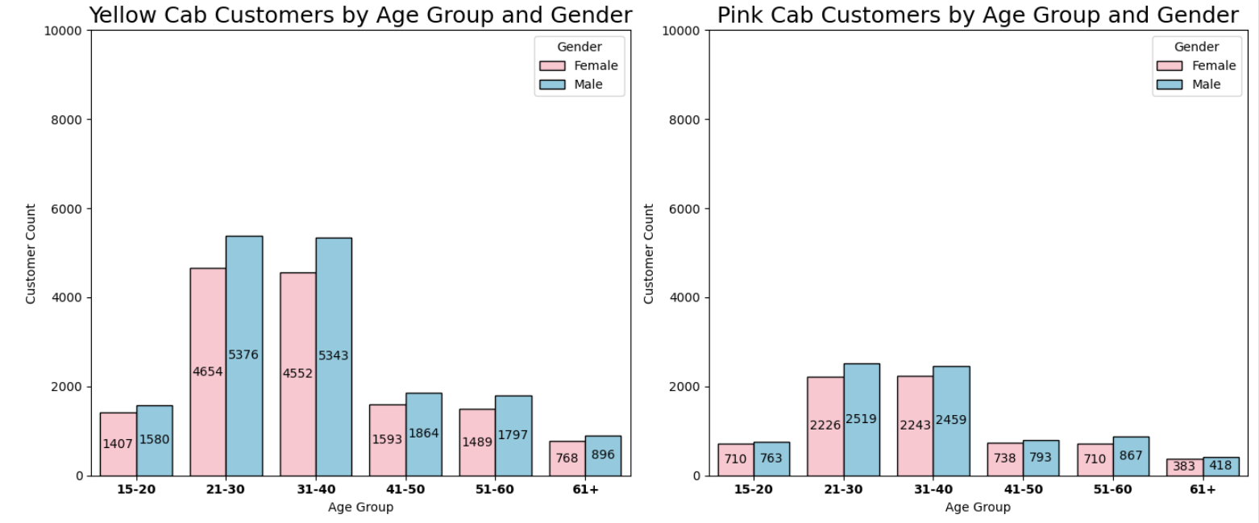
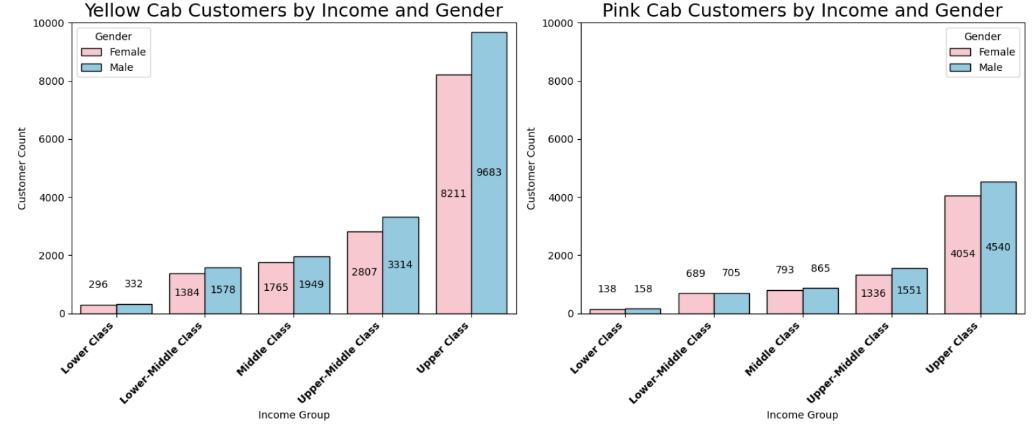
Customer Base Summary
Total Number of Males: 24,675
Yellow Cab: 16,856
Pink Cab: 7,819
Total Number of Females: 21,473
Yellow Cab: 14,463
Pink Cab: 7,010
Total Customers aged 15-20: 4,460
Yellow Cab: 2,987
Pink Cab: 1,473
Total Customers aged 21-30: 14,775
Yellow Cab: 10,030
Pink Cab: 4,745
Total Customers aged 31-40: 14,597
Yellow Cab: 9,895
Pink Cab: 4,702
Total Customers aged 41-50: 4,988
Yellow Cab: 3,457
Pink Cab: 1,431
Total Customers aged 51-60: 4,863
Yellow Cab: 3,286
Pink Cab: 1,577
Total Customers aged 61+: 2,465
Yellow Cab: 1,664
Pink Cab: 801
Total Transactions: 359,392 Total Customers: 46,148
Male Lower Class: 490
Yellow Cab: 332
Pink Cab: 158
Female Lower Class: 434
Yellow Cab: 296
Pink Cab: 138
Male Lower-Middle Class: 2,283
Yellow Cab: 1,578
Pink Cab: 705
Female Lower-Middle Class: 2,073
Yellow Cab: 1,384
Pink Cab: 689
Male Middle Class: 2,814
Yellow Cab: 1,949
Pink Cab: 865
Female Middle Class: 2,558
Yellow Cab: 1,765
Pink Cab: 793
Male Upper –Middle Class: 4,865
Yellow Cab: 3,314
Pink Cab: 1,551
Female Upper-Middle Class: 4,143
Yellow Cab: 2,807
Pink Cab: 1,336
Male Upper Class: 14,223
Yellow Cab: 9,683
Pink Cab: 4,540
Female Upper Class: 12,265
Yellow Cab: 8,211
Pink Cab: 4,054

Slide 8
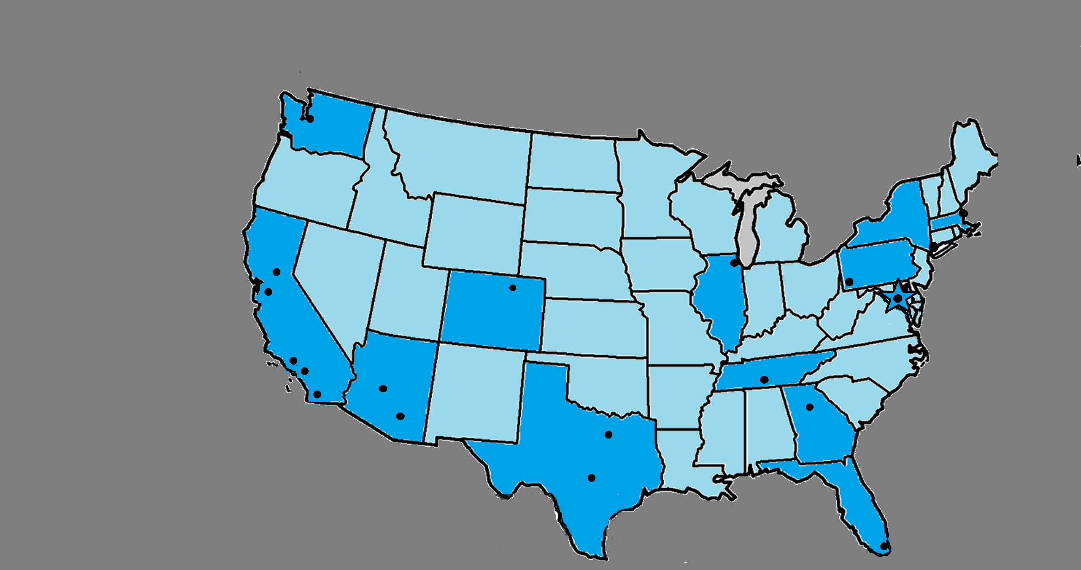
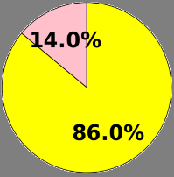
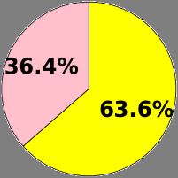
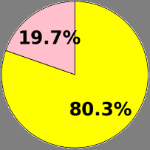
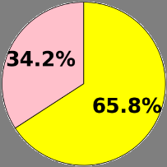
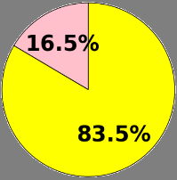
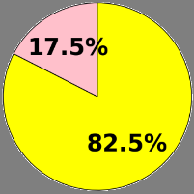
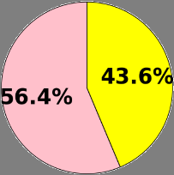
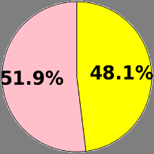
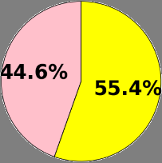
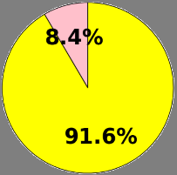
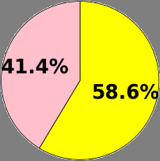
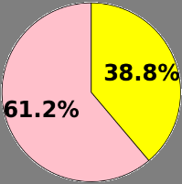
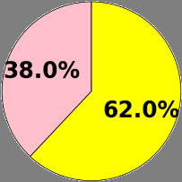
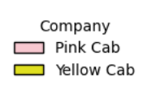
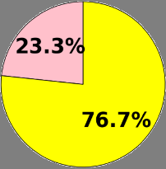
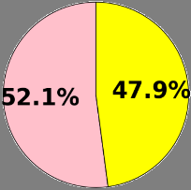
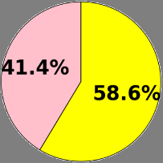
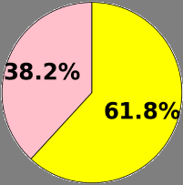
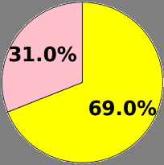
Service Area Demand Summary
19 Cities
1. Atlanta
2. Austin
3. Boston
4. Chicago
5. Denver
6. Dallas
7. LA
8. Miami
9. Nashville
10. New York
11. Orange County
12. Phoenix
13. Pittsburgh
14.Sacramento
15. San Diego
16. Seattle
17. Silicon Valley
18. Tucson
19. Washington DC
Seattle
Boston
New York
Sacramento
Pittsburgh
Chicago
Silicon
Valley
Denver
Washington DC
Los Angeles
Orange County
Nashville
San Diego
Phoenix
Tucson
Atlanta
Dallas
Austin
Miami

Slide 9
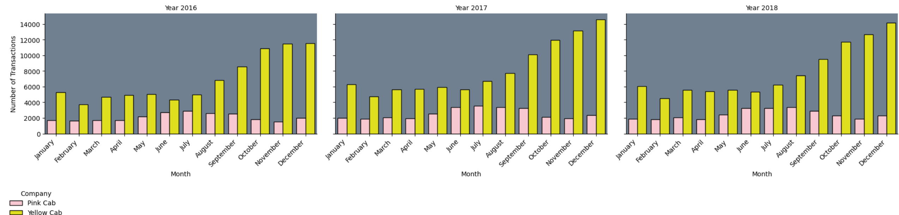
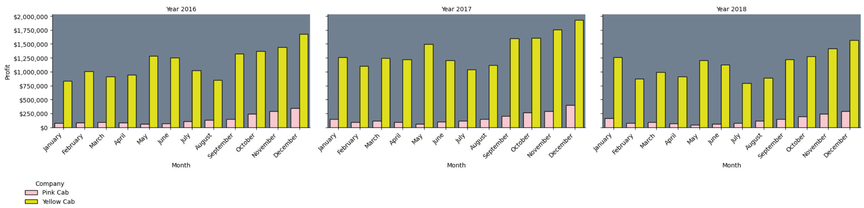
Annual Seasonality

Slide 10
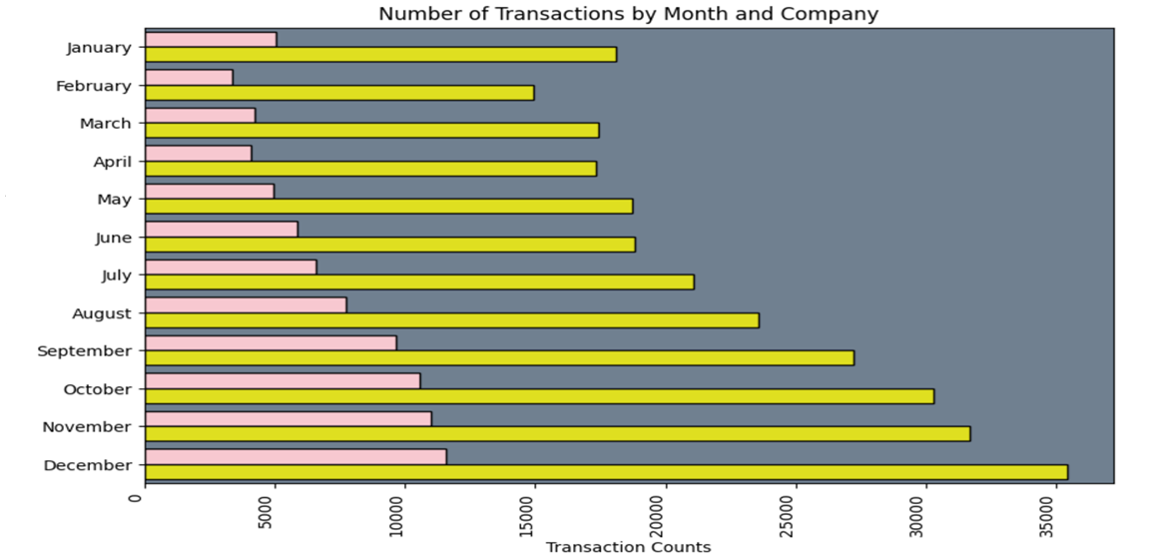
Monthly Demand Seasonality

Slide 11
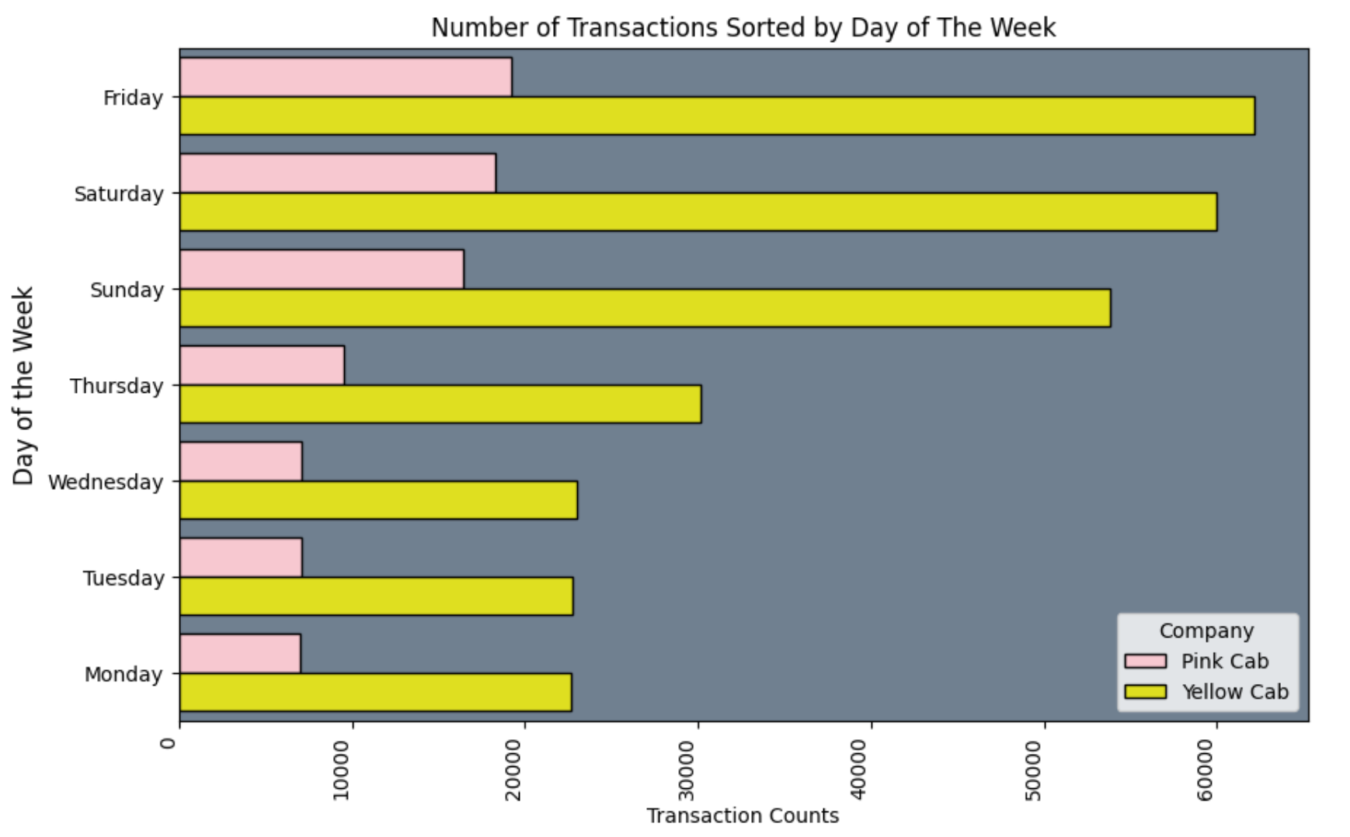
Weekly Demand Seasonality

Slide 12
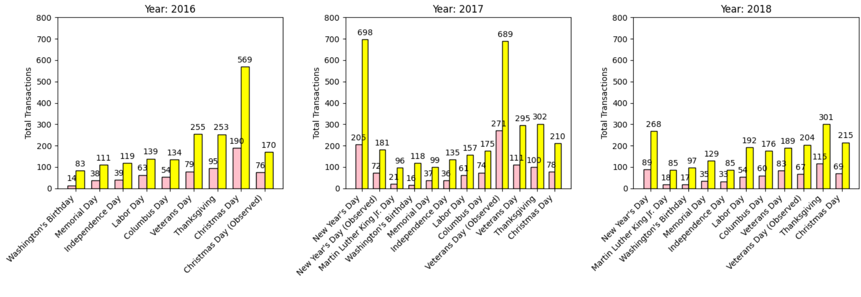
Holiday Summary

Slide 13
Takeaways
Both Yellow Cab and Pink Cab serve all 19 cities.
Yellow Cab does a higher volume of business than Pink Cab.
Yellow Cab has higher profit per KM than pink Cab Company.
There is annual seasonality to the cab businiess.
The winter months have higher ridership than the other seasons.
There is weekly seasonality to the cab business. Friday is the busiest day. Monday is the least busy day.
There is a lot more business on the weekends than the weekdays.
More men ride cabs than women.
The age range most likely to ride cabs is the age range of 20-30 years.
Yellow Cab does double the profit per kilometer than Pink Cab.
In Female ridership, 84% female riders of Yellow Cab are return Riders and only 60% female riders are return riders for Pink Cab.
The income group that utilizes cabs the most is Upper Class.

Slide 14
Recommendations
It is recommended that XYZ company acquire Yellow Cab company.

Slide 15
Thank You

Slide 16

Combined Daily Demand
Hypothesis 1: Is daily demand for cab rides greater on weekdays?
Result: This chart indicates that Friday has the greatest number of transactions. Friday, Saturday, and Sunday have a much greater number of transactions than Monday, Tuesday, Wednesday, or Thursday.
Reject Hypothesis 1.
Hypothesis 1: Is demand for cab rides greater on weekdays?
Answer: NO
INSIGHT: The demand for cab rides is greater on the weekends than the weekdays
INSIGHT: The Yellow Cab company does more transactions than the Pink Cab Company

Slide 17
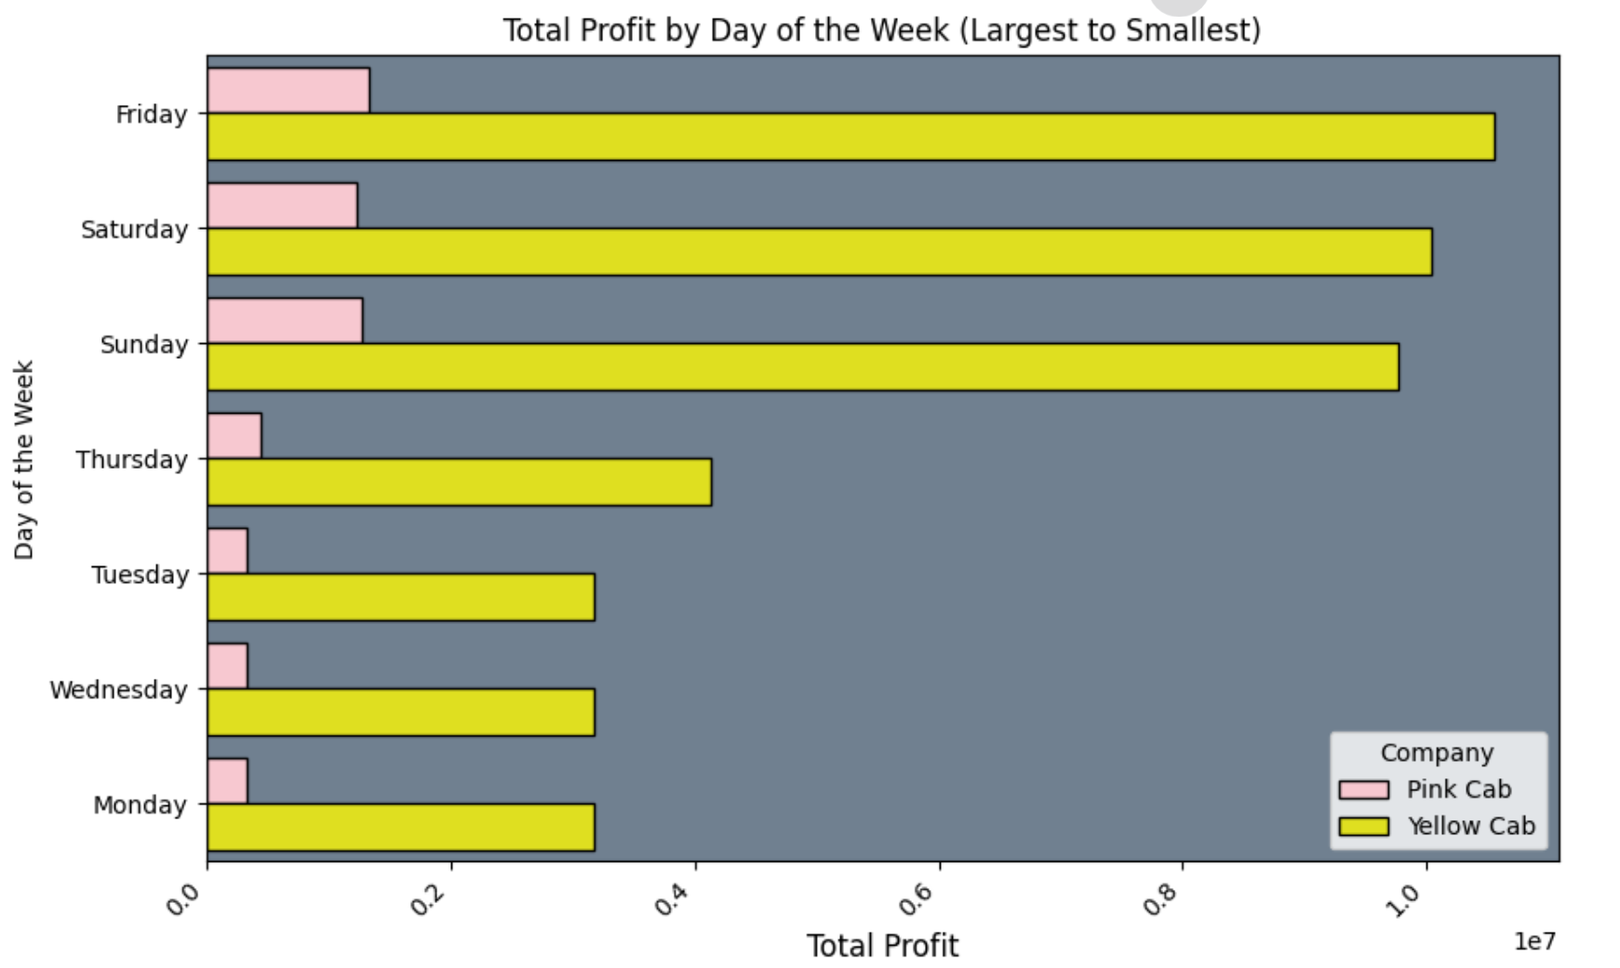
Combined Daily Profits
Hypothesis 2: Are the daily profits greater on the weekend?
Result: The profits are greater on Friday, Saturday, and Sunday than the weekdays.
Accept Hypothesis 2.
Hypothesis 2: Are the daily profits greater on the weekend?
Answer: YES
INSIGHT: The profit from cab rides is greater on the weekends than the weekdays.
INSIGHT: The Yellow Cab company generates more daily profits than the Pink Cab Company.

Slide 18
Combined Daily Profits
Hypothesis 3: Do the daily profits mirror the demand?
Result: The daily profits for the Yellow Cab Company mirrors demand. The daily profits for the Pink Cab Company does not mirror demand.
Reject Hypothesis 3
Hypothesis 3: Do the daily profits mirror demand?
Answer: NO
INSIGHT: There appears to be a great discrepancy in profit and demand for the Pink Cab Company.

Slide 19
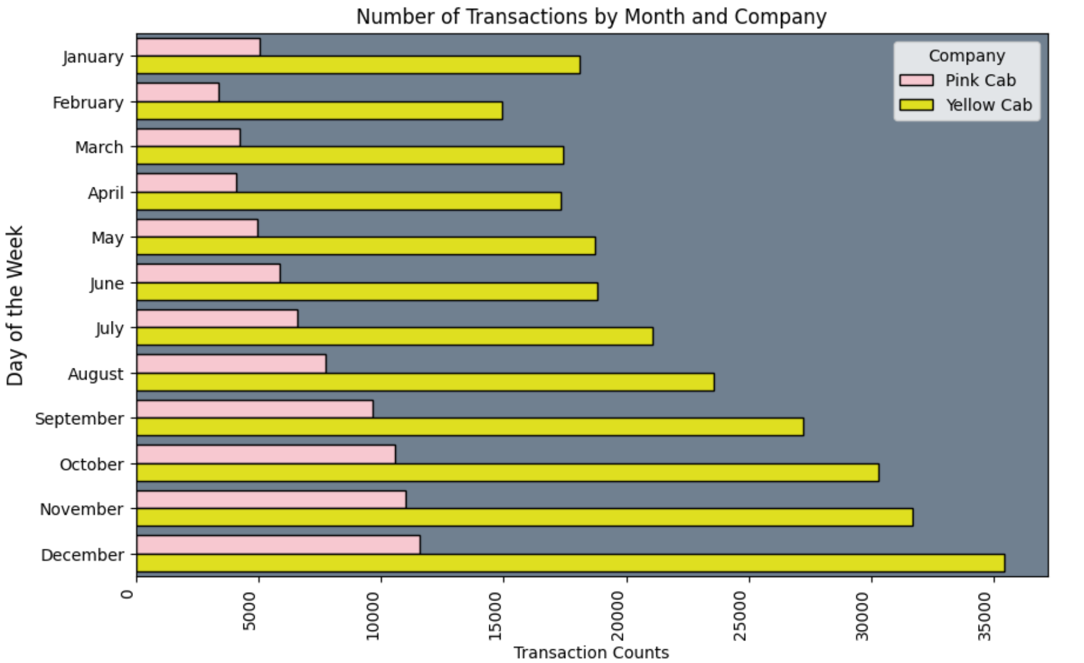
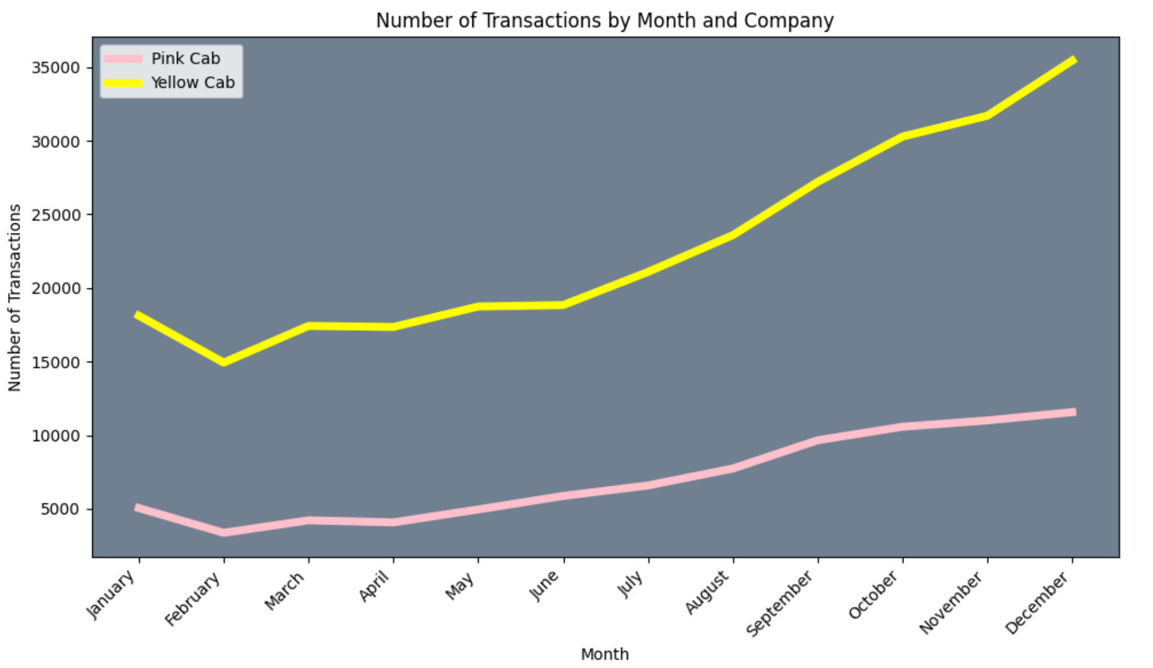
Combined Monthly Profits
Hypothesis 4: Is there seasonality to profits?
Result:
Reject Hypothesis 3
Hypothesis 3: Do the daily profits mirror demand?
Answer: NO
INSIGHT: There appears to be a great discrepancy in profit and demand for the Pink Cab Company.

